Slide 1
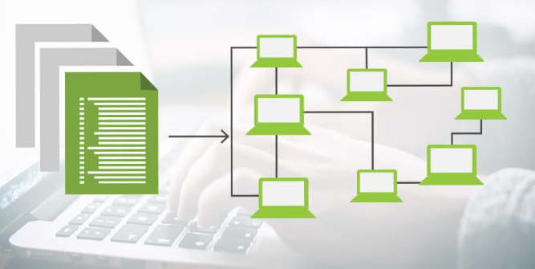
Capstone Project
Infrastructure as Code (IaC)
Veera Gowri Shankar Medisetti
Jamie Drummond
Kalyan Patnala
Nikita Chaurasiya
Ali Khan

Slide 2

Project Overview
Design and Implement Multi-Tier application hosted on Kubernetes & OpenShift
Objective:
Onboard two tenants to Kubernetes and OpenShift platforms with a sample application featuring two microservices.
Deployment Strategy:
Kubernetes: Utilise ArgoCD for continuous deployment of the sample project.
OpenShift: Implement the Source-to-Image (S2I) pipeline for application deployment.
Automate Infrastructure deployment and configuration using Terraform and Ansible, utilise CI/CD for applications.
Monitoring:
Leverage the ELK Stack (Elasticsearch, Logstash, Kibana) to monitor application performance and logs.

Slide 3
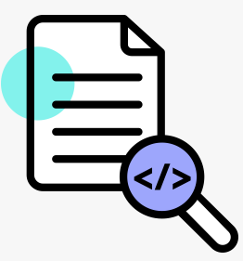
Workflow Overview (Kubernetes hosted Application)
Infrastructure Deployment
Notes:
Presenter Ali 4 minutes max
We will take you through the flow and components used to deploy AWS infrastructure, VPC, subnet, EC2 instances, routing security groups etc.
We used our workstation to write initial code
Installed Terraform and connected it to terraform cloud to be used as a Continuous delivery tool. Terraform was used to provision infrastructure.
Code is saved in a local GIT repo which is merged with remote repo, GIT is our VCS version control system.
Build integration between terraform cloud and GIT. Configured necessary access and API keys.
Code was pushed from local repo to remote, Terraform cloud detects change and triggers build.
We now have all the components. Architecture : we have 4 ECS2 machines, one has ansible installed and configured using terraform . Other 3 EC2 machines are prepared to be used as K8s cluster
Ansible playbook configured docker and K8s cluster and argo CD as a container.
Access Argo CD https://52.18.206.54:31037/ >> m9xg-SlVob3jIW53
Repo Used: https://github.com/shujali/st-project
Terraform Cloud: https://app.terraform.io/app/ali-networks/workspaces/prod

Slide 4
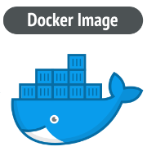
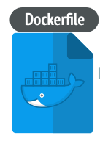
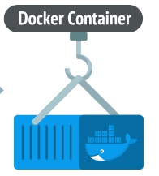
Workflow Overview (Kubernetes hosted Application)
Container Images
Docker Hub
Git Hub
Notes:
Presenter Nikita ad Veera 6 minutes max for 4, 5 and 6.
In this slide we are showing what we learned about container images, docker files and how to build containers

Slide 5

Workflow Overview
Application Deployment On K8s Cluster using ArgoCD
Docker Hub
Notes:
Presenter Nikita ad Veera
Kubernetes application deployment using ArgoCD, in this slide we will show application deployment using ArgoCD which is managing deployments, service creation etc for new apps.
Required Yaml files such as deployment and service are pushed to the repo
ArgoCD monitors repo and triggers the required build
https://github.com/KalyanPatnala/argocd11
Access Argo CD https://52.18.206.54:31037/ >> m9xg-SlVob3jIW53
Kubernetes needs container images to be pre-built

Slide 6
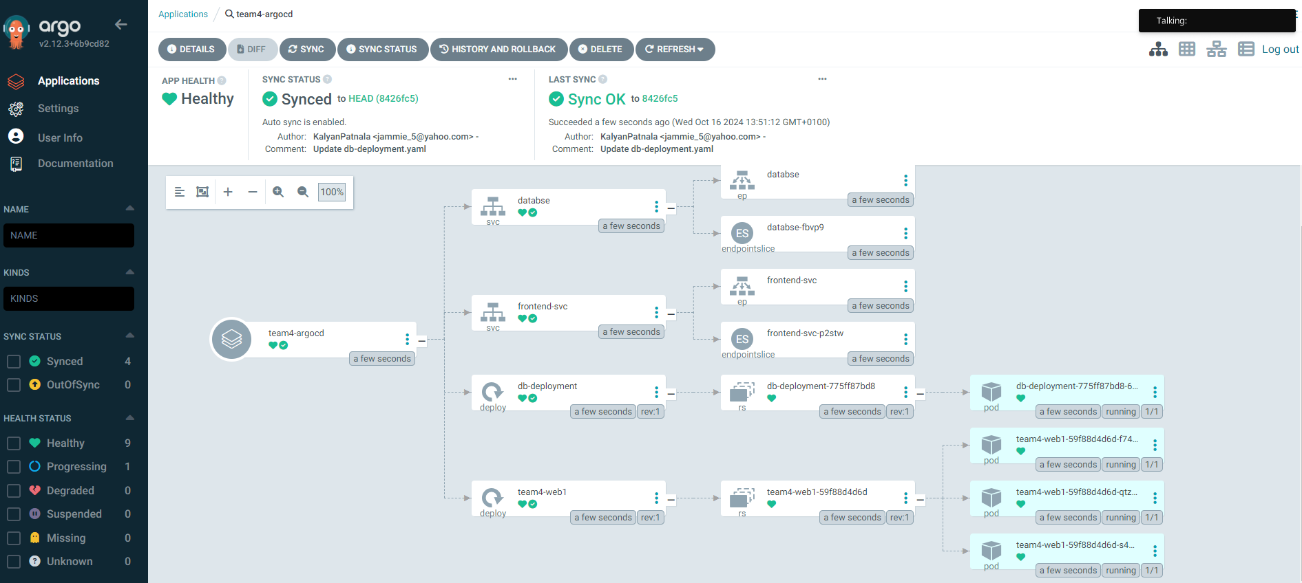
Notes:
Presenter Nikita ad Veera

Slide 7
Workflow Overview
Application Deployment on OCP using S2I
Build Config
*Build Image
*Create Deployment
*Create Services
*Other required application runtime objects
*Deploy and Expose application
Deployment Config
Notes:
Presenters Kalyan And Jamie 5 or 6 minutes with demo included
OCP Application using S2I
In this slide, we are showing power of OCP with S2I,
OCP will combine all tasks from image building to app deployment
https://github.com/KalyanPatnala/team4-oc-database
https://github.com/KalyanPatnala/team4-oc-frontend
Have a CLI and GUI access ready to OCP console
Browse to web page of our app and get the screen ready to share
At the end of presentation. Jamie brings CLI and GUI on sharing screen >> Kalyan makes change to insert value file in GIT >> Shows the pods rebuilding and show web page changes

Slide 8
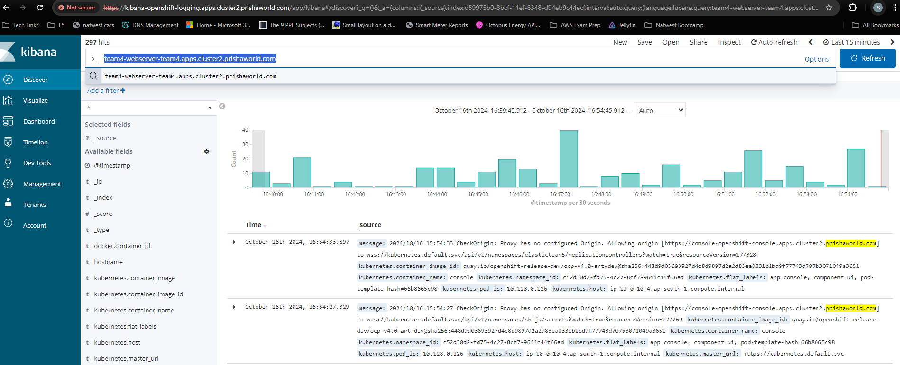
Notes:
Add monitoring Screenshots here
Kalyan and Jamie

Slide 9
Q & A

